Slide 1
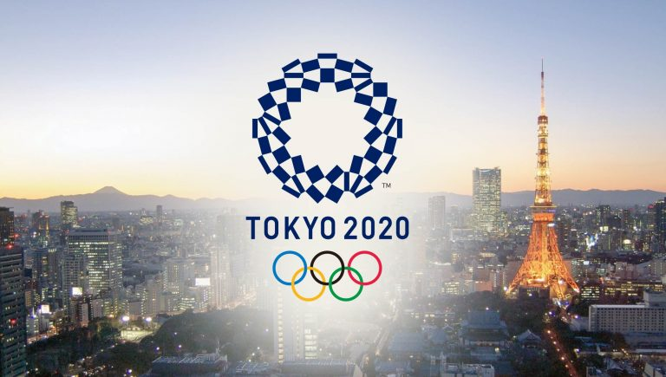
ALTSCHOOL OF
DATA ANALYSIS
CAPSTONE PROJECT REPORT
ON
TOKYO 2020 SUMMER OLYMPICS GAMES
By:
OJOH CHIEMELE DAVID
MAT NO: ALT/SOD/023/0702

Slide 2




WORK FLOW
OVERVIEW & INTRODUCTION
PROJECT METHODOLOGY
DATA DRIVEN INSIGHTS
RECOMMENDATIONS
01
02
03
04
1

Slide 3
INTRODUCTION & OVERVIEW
The 2020 Summer Olympics, officially known as the Games of the XXXII Olympiad, was held in Tokyo, Japan.
The event was originally scheduled to take place from July 24 to August 9, 2020, but was subsequently postponed to July 23 to August 8, 2021, due to the COVID-19 pandemic. Despite being held in 2021, the event retained the "Tokyo 2020" branding.
The games was hosted across 41 venues in Tokyo and surrounding regions.
It also featured the introduction of new sports, such as skateboarding, surfing, sport climbing, and karate, as well as the return of baseball/softball.
These additions aimed to attract a younger audience and reflect modern athletic trends.
Approximately 11,500 athletes from 206 Nations also known as National Olympic Committees (NOCs) participated in the Games.
The competition included 339 events across 46 sporting categories.
2

Slide 4
PROJECT METHODOLOGY
DATA SOURCE
The Dataset used for the project was gotten from Kaggle, and National Olympics committee official website.
DATA EXTRACTION
Microsoft Power BI was the tool of choice used for Data Modeling, Cleaning, Transformation and visualization.
The dataset was imported into Power Bi and consists of 5 tables; Athletes, Coaches, Technical Officials, Medals and Medals Total Tables, 2 other smaller tables containing Host Cities and Venues were added to enhance and add value to the overall findings and presentation.
DATA MODELING
Transformation and Modeling of the entire dataset was done using the Power Query Editor on Power BI, by going through each table column after another, the unnecessary columns and rows were deleted, checked for duplicates in all 5 tables, renamed some columns for easy understanding, checked each column setting to ensure the appropriate data type for each of them, all these to ensure data accuracy.
The Table Relationships were checked to enable us know and ensure that a proper link is established between the different tables in the dataset, this is to ensure Numerical Data Accuracy and overall Visualization Synchronicity.
3

Slide 5
PROJECT METHODOLOGY
DATA VISUALIZATION
statistics were performed by creating Measures like Average, Mean, and interactive visualizations were created by use of Column, Doughnut, Gauge, KPI, Matrix, Tree Maps etc. charts, to uncover valuable insights from the data.
PROJECT USED CASES
Participating Countries/National Olympic committees (NOC) and their total number of participating Athletes.
Athlete’s gender distribution, average age (Identifying the youngest & oldest athlete) and their demography.
Medals won by participating Nations and Medals won by Individual Athletes, top performing Nations and Athlete by medal count.
Sports event/activity participations and Ranking by Medals won.
Technical officials and Coaches gender distribution, average age and identifying the youngest & oldest in these 2 categories.
CONCLUSION & RECOMMEDATIONS
Conclusions were drawn from the entire analysis carried out, actionable recommendations were made following the results and insights gotten from the entire data analysis process.
4

Slide 6
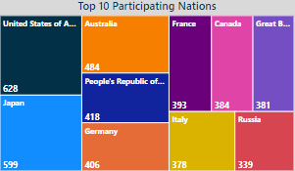
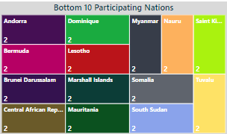
ANALYSIS & INSIGHTS
USA, Australia, Japan, China and several other Western Countries had the highest athlete’s participants, as has been the case over the years in Summer Olympic Games, This is because of their vested interest in diverse sports, like gymnastics, Athletics, field events, Horse riding etc. thus their Athletes are groomed from an early age to specialize in these sports ahead of future Olympics games and other competitions like Common Wealth games and the Diamond league.
While Countries like Andorra, Lesotho, Somalia etc. were amongst to lowest participating Nation as these countries are relatively small both in Size and in Population, some of the Countries are third world countries, thus they’re under developed and have little or no interest in investing in diverse sporting categories like their Western more developed counterpart.
See Visuals for clearer understanding
5

Slide 7
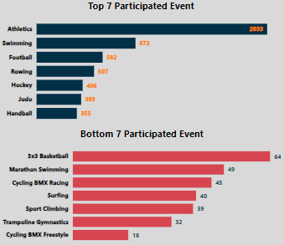
ANALYSIS & INSIGHTS
Athletics has the vast majority of Participants as it cover several sporting events ranging from Road, Track and Field events and its subcategories, e.g. marathon, 100, 200meters race, short-put, high Jumps, pole volt etc.
Swimming, Football, Judo and other events in the Top 10 are also very popular sporting activities, hence their high participation.
Majority of the sporting activities in the bottom 10 cadre were recently introduced into Olympic competitions, particularly SPORT CLIMBING, BMX FREESTYLE and SURFING were featured for the first time in a summer Olympic Games, making them less popular to athletes and overall participation.
6

Slide 8
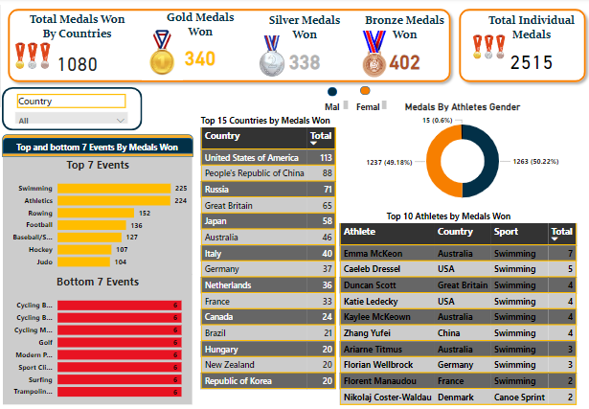
ANALYSIS & INSIGHTS
The total medals won by participating Nations was 1080, with USA being on top of the medals table having won 113 medals, while the total medals won by Athletes was 2515.
This noticeable difference in MEDAL COUNT between the Athletes and Nations/Countries is as a result of Team Sports & Events that requires 2 or more Athletes to compete in them, e.g. Football, Basketball, Volleyball, Water Polo, Rowing, and Mixed events like Synchronized Diving, Tennis etc.
Athletes who won Gold, Silver or Bronze Medals in these sports/events are given individual medals, whilst it is counted as just 1 medal for the Countries/Nations they represent.
E.G. Brazil won the men’s football Gold Medal, each of the 23players in the team were all given medals, whereas the medal was just counted as 1 MEDAL for their Nation BRAZIL
93 out of 206 Nations won at least 1 medal.
Emma Mckeon (F) from Australia and Caeleb Dressel (M) from USA both emerging as the top medal winners with 7 & 5 medals respectively, and both participated in swimming events.
7

Slide 9
GENDER INSIGHTS
There was relatively a good balance in Athlete’s participation and medals won by gender
Male Athletes 6002 (52.2%)
Medals 1263 (50.22%)
Female Athletes 5495 (47.8%)
Officials & Judges 683 (71.44%)
Medals 1237 (49.18%)
Coaches 312 (76.66%)
Officials & Judges 273 (28.56%)
More Females should be trained and encouraged into becoming Technical officials and Sporting coaches as their numbers were very low in these categories, as this will help bridge the gap in future Summer Olympic Games
Coaches 95 (23.34%)
2.6% of Athletes refused to be identified by their gender, and some are medal winners
8

Slide 10
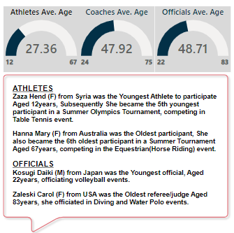
ANALYSIS & INSIGHTS
The 2020 Summer Olympic Games had the record of Participation by Countries and Races, as 206 Nations and Recognized Territories were represented in at least 1 Olympic Sporting Event, either as an Athlete, Coach or an Official.
The Overall hosting and safety measures implemented across the entire Olympic games to ensure a covid-19 FREE event, by the host Nation Japan were HIGHLY COMMENDABLE despite the delay in hosting the event for 1 year, as the world was battling one of the toughest Pandemic (Covid-19) in nearly 200 years.
9

Slide 11
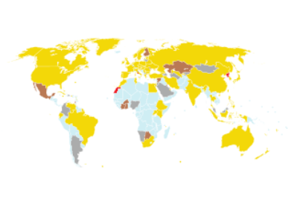

CONCLUSION
Majority of the Medals were won by Western & Asian Countries, and they also have the highest numbers in athlete’s participation as they have interest in diverse Sporting activities, not just common sports like Football, Swimming and Tennis, thus their Governments and agencies invest heavily in sporting facilities, to ensure that their athletes a well drilled and trained for competitive events like the Olympic Games.
Overall, The Tokyo 2020 was a huge success as it served as a platform for the entire world to come together once again in oneness after a Global Devastation caused by the Covid-19 Pandemic.
South American and Particularly African Countries won the least amount of medals
10

Slide 12




RECOMMENDATIONS
01
02
03
04
African and South American Countries with their love for FOOTBALL should be encouraged to diversify and invest into other sporting activities, particularly Athletics as it has diverse sporting categories.
World governing bodies for sports should aid these countries by establishing sporting facilities that will help athletes train more efficiently particularly in sports events were they are underperforming.
Develop a strategic plan for improving performance in identified areas, whilst incorporating best practices and training regime from top-performing countries in those sport.
Athletes in these Countries should be scouted for and trained from an early age so as to imbibe the winning mentality in them from childhood, as it is common practice in the Western World.
These recommendations if implemented will help bridge the gap between African & South American countries with their Western Counterparts in future Olympics competitions
11

Slide 13
RECOMMENDATIONS

